Slide 1

Prototype of a video game
for computer using Unity
____________________________
Bachelor’s Degree in Video Game Design and Development
Latorre Freixes, Marc
Zúñiga Zarate, Ana Gabriela

Slide 2
INDEX
1. Objectives
2. Planification
3. Methodology
4. Market Research
5. Development
6. Future work
7. Conclusions

Slide 3
Creating the prototype
Design the whole game
Manage all the tasks
Achieve a fun gameplay
Balance the prototype
Carry out a useful playtesing
Create an item system
1. OBJECTIVES
Title Two

Slide 4
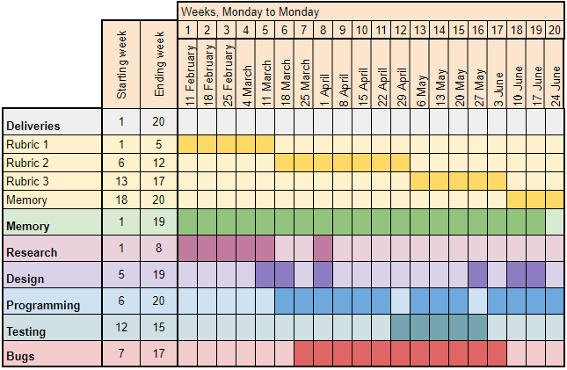
2. PLANIFICATION

Slide 5

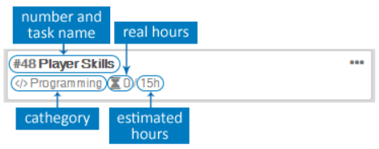
2. PLANIFICATION
Evaluation tools
External playtestings
Personal and close people playtestings

Slide 6
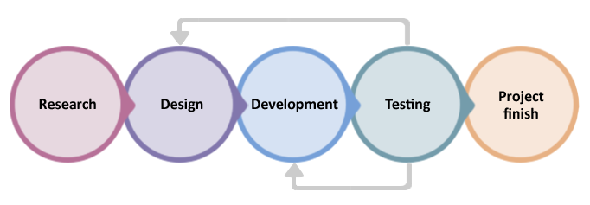
3. METHODOLOGY Scrum

Slide 7
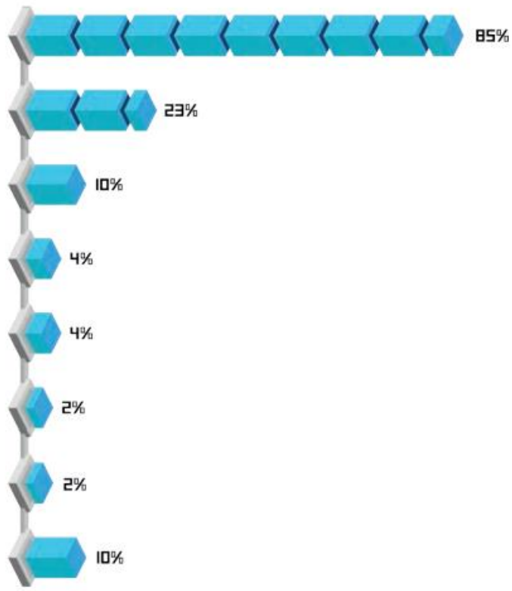
4. MARKET RESEARCH Engines used in Spain
Unity
Unreal
Own engine
Corona
GameMaker
RPG Maker
Cocos2d
Others
Font: White book Spain Dev 2018

Slide 8



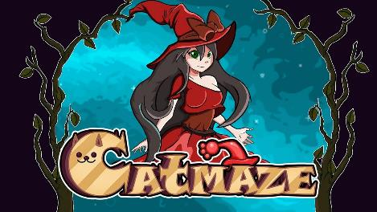

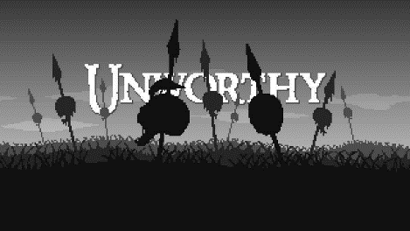

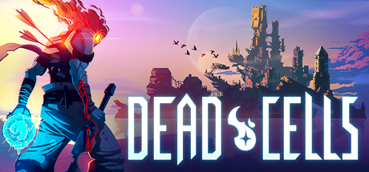
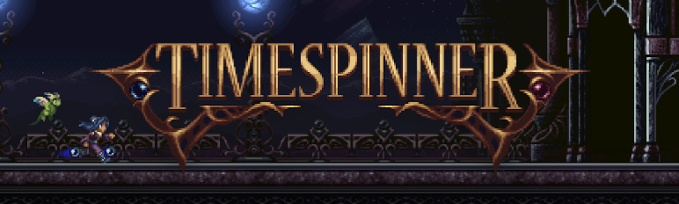
4. MARKET RESEARCH Similar games comparison

Slide 9
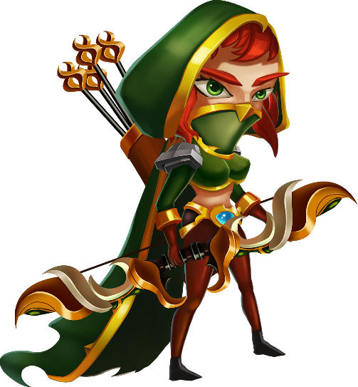


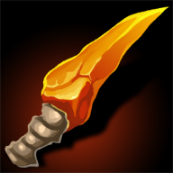




5. DEVELOPMENT Assets research

Slide 10


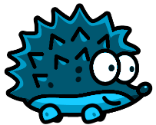
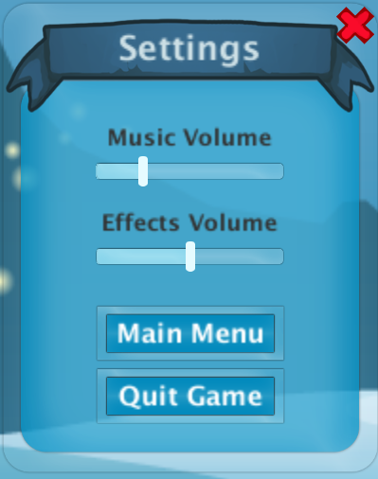
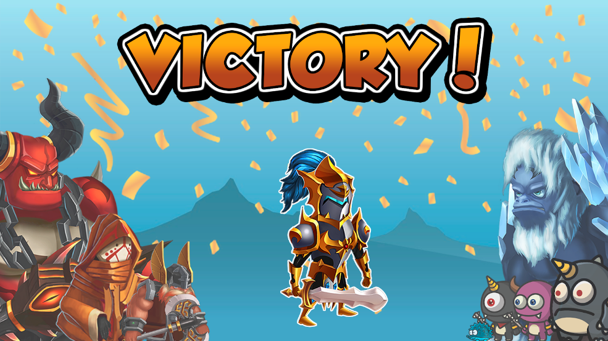






5. DEVELOPMENT Sprites creation and modifications

Slide 11
5. DEVELOPMENT Design
Game Pillars
Gameplay
Gameplay goes before anything
Mobility
Player has a high mobility
Fast
Both combat amb movements are fast

Slide 12
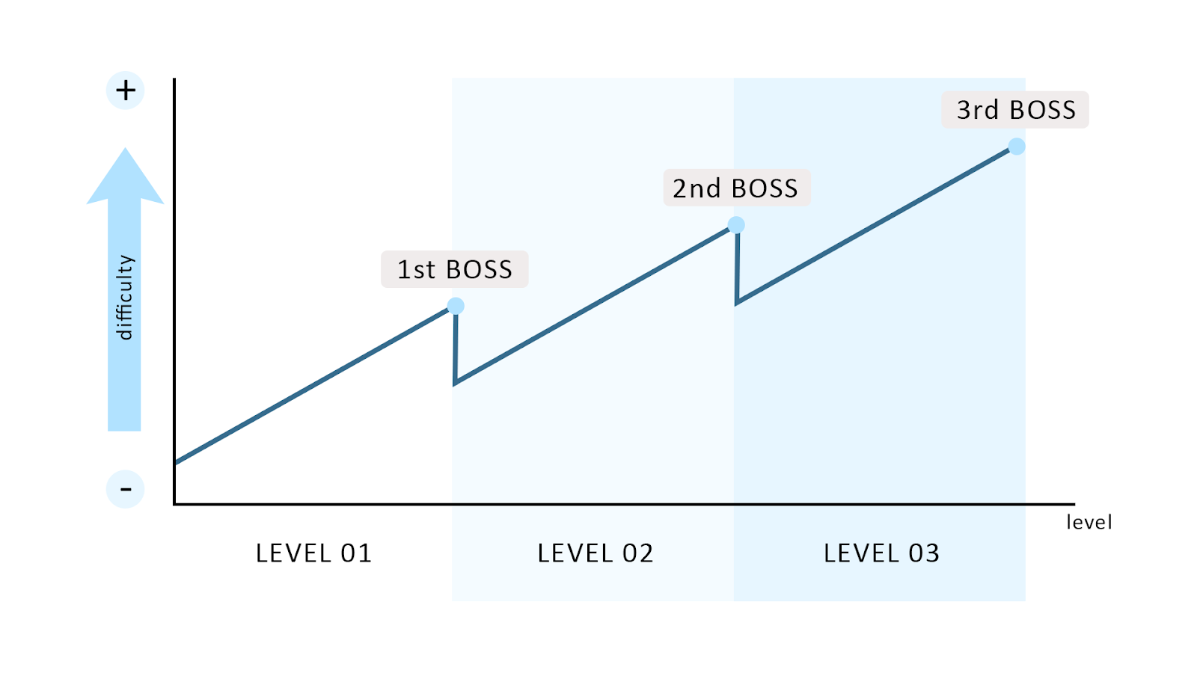
5. DEVELOPMENT Design - Flowchart

Slide 13
5. DEVELOPMENT Design and Programming - Levels
Level 1
Level 2
Level 3
· Moving platforms
· Ice lances spawners
· Fire balls spawners
· Moving platforms
· Ice lances spawners
· Fire balls spawners
· Jumping platforms
· Spikes
· Moving platforms
· Ice lances spawners
· Spikes

Slide 14



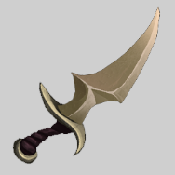



5. DEVELOPMENT Design and Programming - Player skills
Skills .
Buffs .
Dash
Sharp sword
Extra armor
Dagger throw
Blood sword
Dark shadows
Deflection

Slide 15
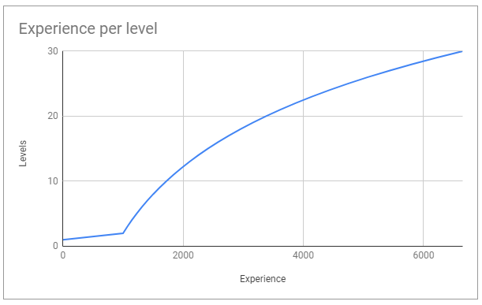
5. DEVELOPMENT Design and Programming - Player levels and experience

Slide 16
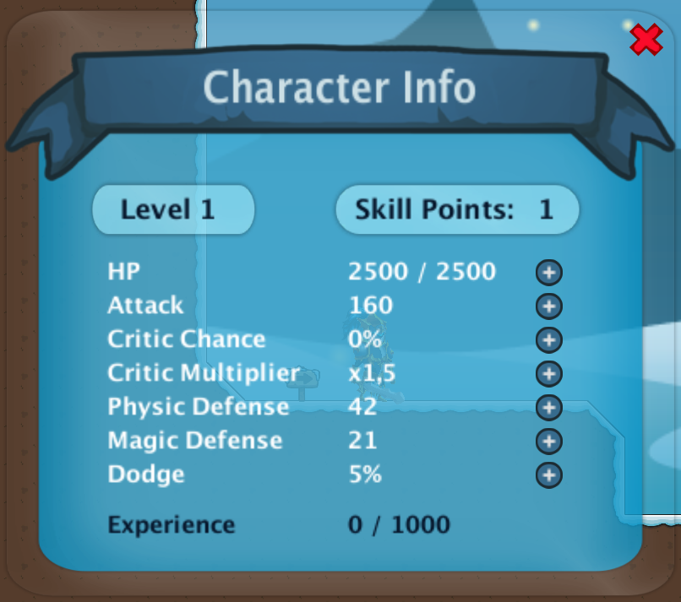
5. DEVELOPMENT Design and Programming - Player upgrades

Slide 17
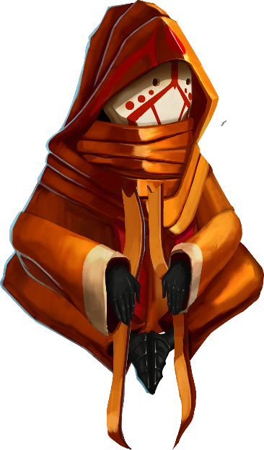
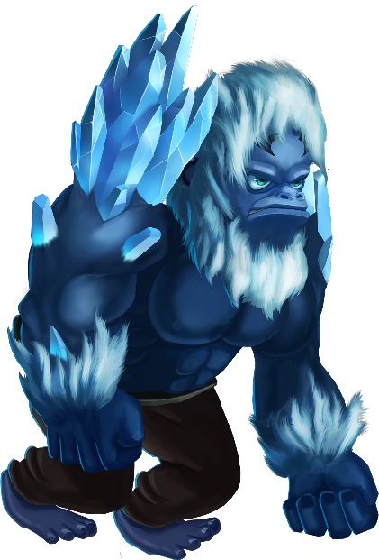
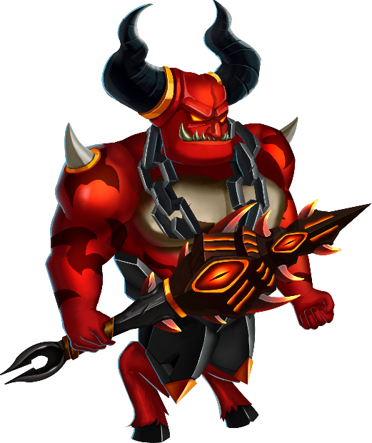
5. DEVELOPMENT Design and Programming - Bosses
Monk | 1st Boss
Ice Gorilla | 2nd Boss
Demon | 3rd Boss

Slide 18
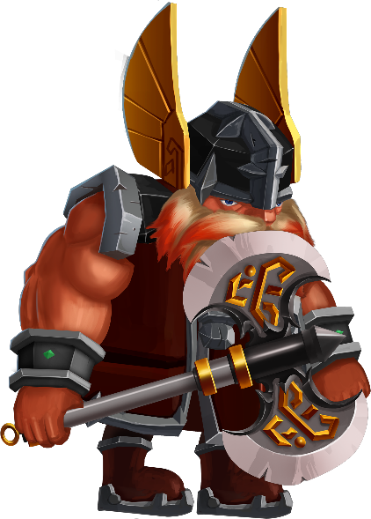
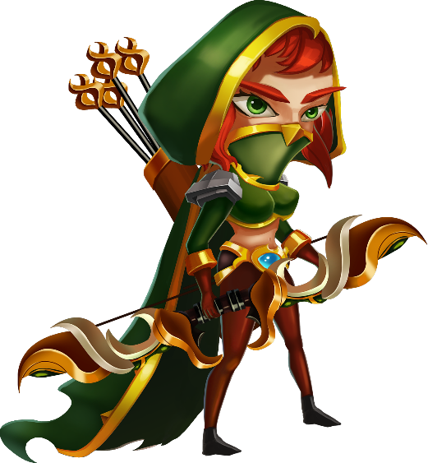
5. DEVELOPMENT Design and Programming - Enemies
Dwarf
_______
Levels 1, 3
Archer
_______
Levels 1, 2, 3

Slide 19
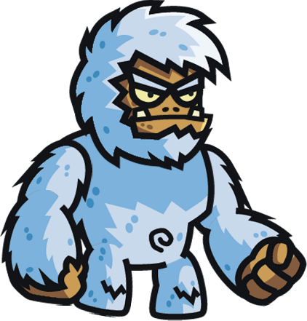

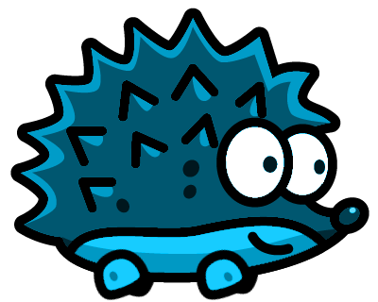
5. DEVELOPMENT Design and Programming - Enemies
Blue hedgehog
_______
Levels 1, 2, 3
Little Yeti
_______
Level 2
Fluffy monster
_______
Levels 2, 3

Slide 20

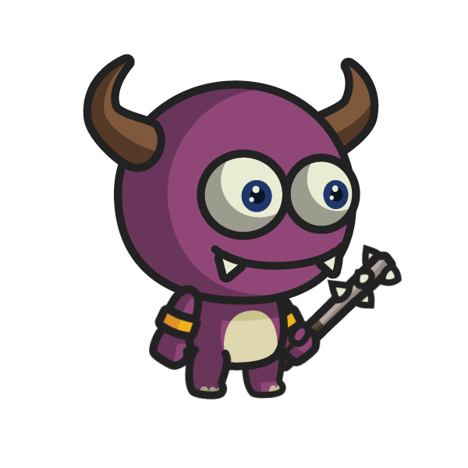
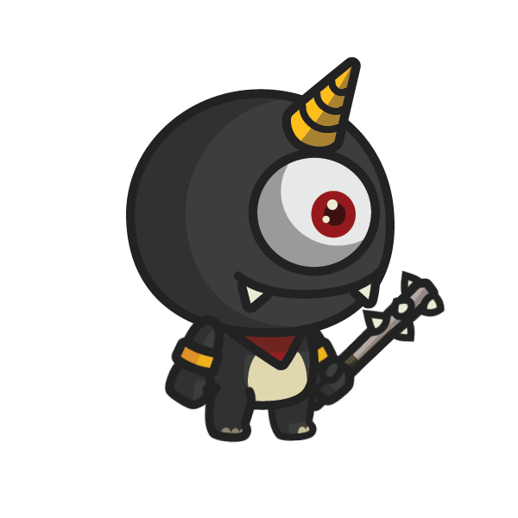
5. DEVELOPMENT Design and Programming - Enemies
Lizard monster
_______
Level 3
Imp
_______
Level 3
One Eyed Imp
_______
Level 3

Slide 21
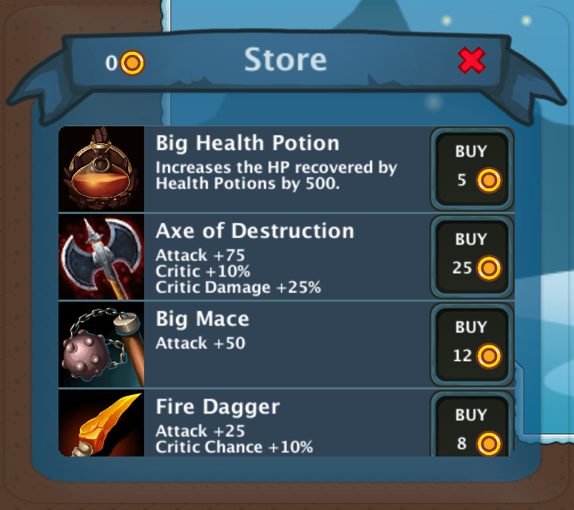


5. DEVELOPMENT Design and Programming - Items
Collectables .
Store .
Health potion
Coins
Key

Slide 22
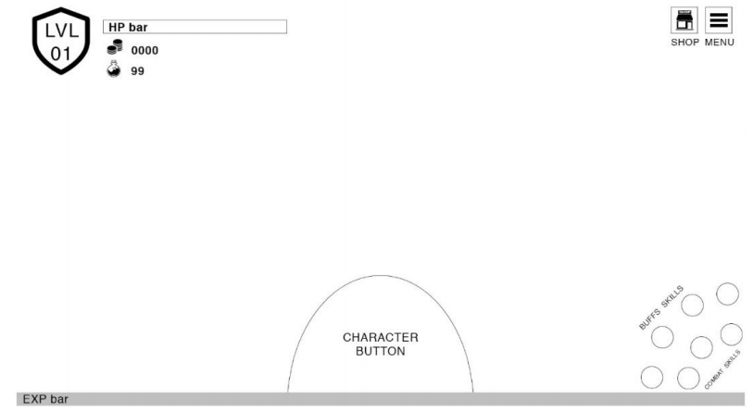
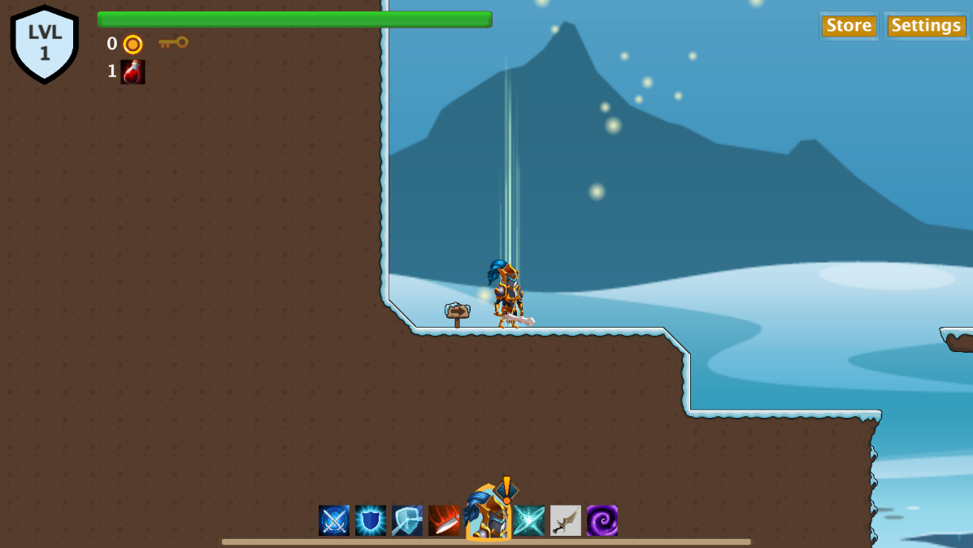
5. DEVELOPMENT Design and Programming - User Interface

Slide 23

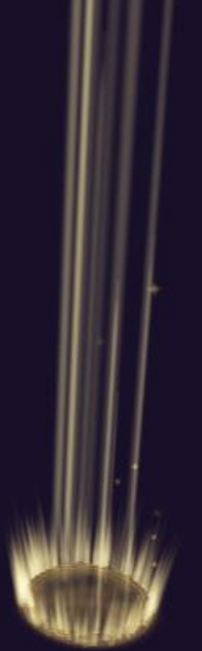
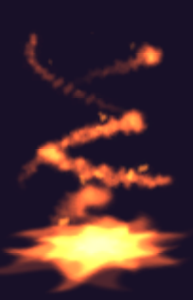




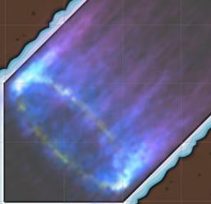
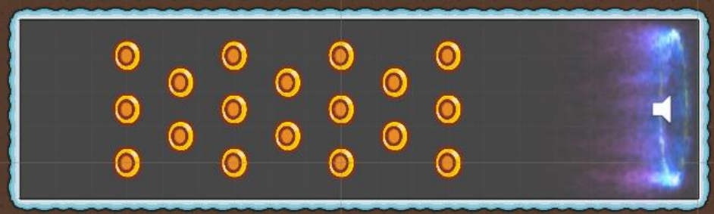


5. DEVELOPMENT Personal and close people playtestings

Slide 24
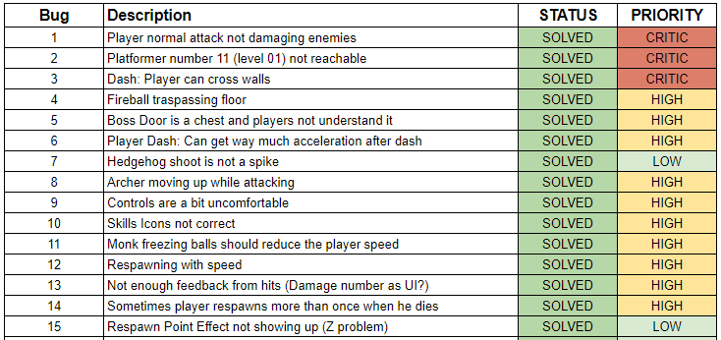
5. DEVELOPMENT Bug Tracking

Slide 25
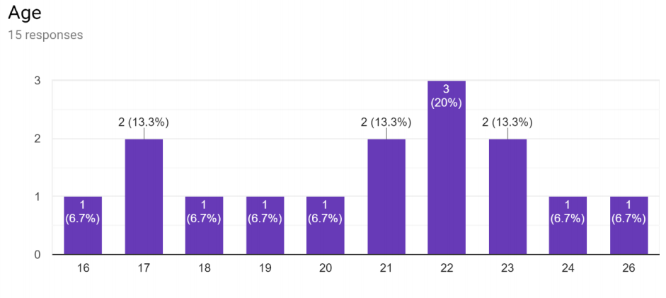
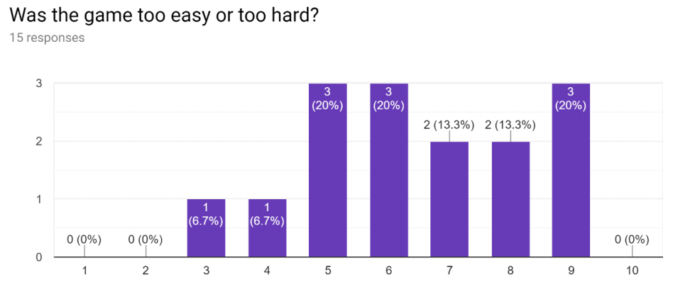
5. DEVELOPMENT 1st external playtesting

Slide 26
5. DEVELOPMENT 1st external playtesting - input changes
Control | Key Pre Playtesting | Key Post Playtesting
Move left | A | A
Move right | D | D
Jump | SPACE | SPACE
Use health potion | S | S
Normal attack | Q | Mouse right click
Dash | W | Shift
Throw dagger | E | Mouse left click
Dark shadows | R | W
Improve attack buff | 1 | 1
Improve defense buff | 2 | 2
Reflect damage buff | 3 | 3
Life steal buff | 4 | 4

Slide 27
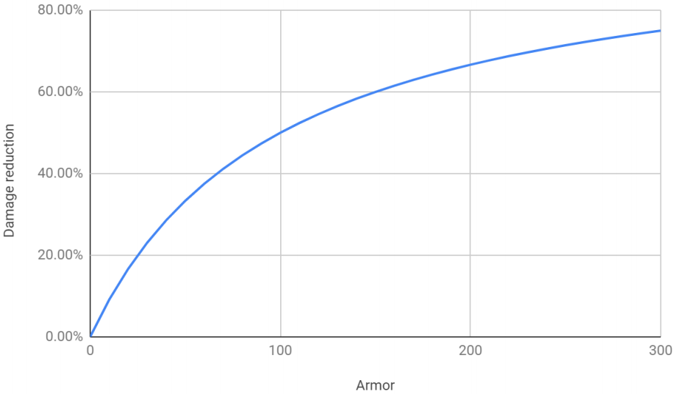
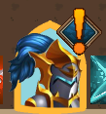
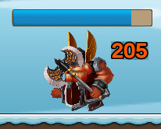
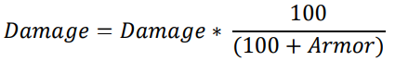
5. DEVELOPMENT 1st external playtesting

Slide 28
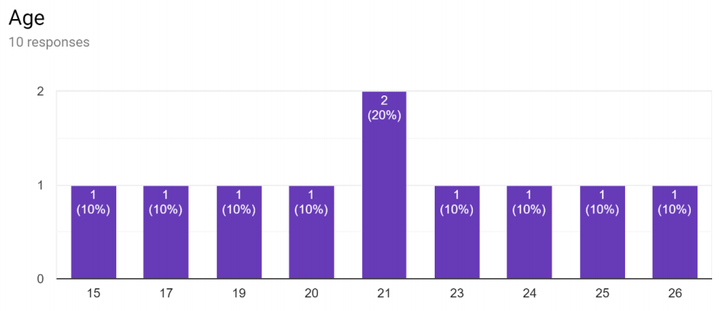
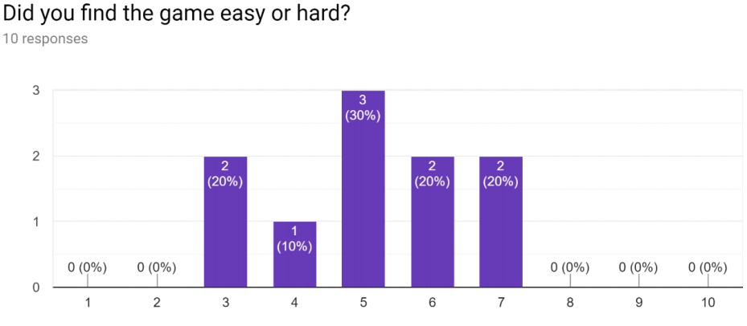
5. DEVELOPMENT 2nd external playtesting

Slide 29

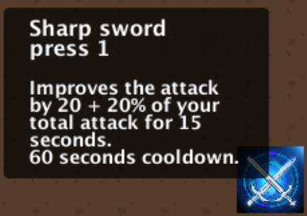
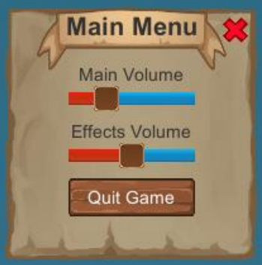
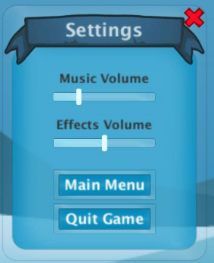

5. DEVELOPMENT 2nd external playtesting

Slide 30
6. Future work
+ Player skills
+ Enemies
Crouching
Levels score
Achievements
Save and load

Slide 31

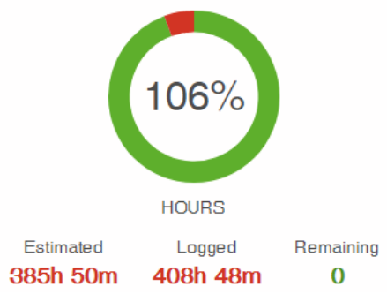
7. CONCLUSIONS
Creating the prototype
Design the whole game
Manage all the tasks
Achieve a fun gameplay
Balance the prototype
Carry out a useful playtesing
Create an item system
Title Two

Slide 32

MAKING OF

